Slide 1
3-D Jewelry Creations
Erick Corona-Ramirez
Miguel Guzman Valle
Stephanie Gonzalez
Xue Feng
Yijing Cheng

Slide 2
Business Idea
By utilizing the demand and interest of jewelry usage from people who want to buy something that looks nice at an affordable price, our business can satisfy those demands. The development of 3D printing has allowed us to create products that are affordable for the people. Our goal is to provide luxurious jewelry that will make people who receive our products thrilled. We will achieve this by offering in house custom designs, and customers can send their own design to have it custom made with materials that they want. With our only store being located in Pasadena, CA.

Slide 3
Competition
With not a lot of people using or having a 3D Jewelry store front and showing how personal a piece of jewelry can be by customizing to meet the customers requirements. The uniqueness of this idea gives us the competitive advantage towards other jewelry stores.
Competitive Rivalry
Threat of New Entrants
Bargaining Power of Buyers
Threat of Substitutes
Bargaining Power of Suppliers
Threat of New Entrants:
Low to medium
Many people can open online business to offer 3D jewelry but, we can handle this by offering fast service and save on shipping
Competitive Rivalry:
Medium
There are a few online 3D Jewelry businesses and some people would rather online than go in person but, we can handle this by offering lower prices than online and letting the customer come in store if they need help designing.
Pugster Inc. would be one of our competitive rivals as they are basically doing what we are going to do. Although, the area in which we would be located is a bit different but, still they will have more history.
Bargaining Power of Buyers:
Medium to High
By providing a service in helping the customer design the piece of jewelry it will give us the advantage on either making the customer return or have them tell others.
Threat of Substitution:
Low
There is already a few 3D Jewelry stores online plus who knows if there might be some with a store front in other countries. But within the area of our location there isn’t as many.
Bargaining Power of Suppliers:
Low
The only suppliers needed will be the wax for the jewelry. We will have our own manager in charge of fixing the 3D Printers incase anything goes wrong.

Slide 4
Role of Information Systems
The use of information system will allow us to collect data and applying it by understanding the demographic information of what people spend their hard earn income. How much they spend in apparel/ accessories (jewels/jewelry).
We will also get information about how well our nearby competitors preform and collect data of the expenses require to maintain the business. No to mention the demands of our clients and what they would desire to see in our store.

Slide 5
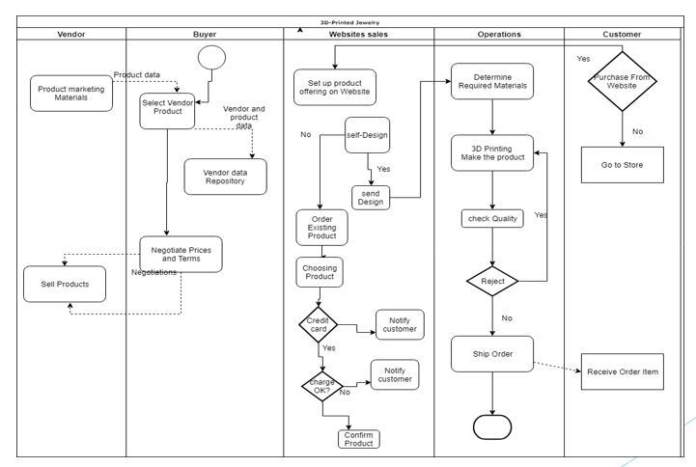
Role of Information Systems

Slide 6
Revenue
We will generate revenue through, up or down scaling the quality of the metals used in our jewelry. For example if a customer comes in need of a ring, since we 3-D print the Jewelry in store the customers can choose to have the ring band made from silver, gold, white gold, or whatever way they want/need on the spot. This allows us to reach a larger demographic of customers which helps us to generate high sales.
Another way to generate revenue is if the customer wishes to add gems or diamonds to their jewelry. If so, they can go talk to our jewelers for a more personal and tailored experience when designing their customized jewelry. By providing such experience it allows us to reach the luxury market of jewelry to help generate revenue.
Lastly, we will also include a service where customers can design their jewels from scratch so, they can truly have a one of a kind piece of jewelry. This service will attract more clients, which will allow us to generate more revenue.

Slide 7
Customers
Our mission is to provide good and reliable jewels and jewelry to all ages. Even though that is our main goal, the specific age we’re targeting is from12 years old and up. The Reason behind this is because many young people like to keep up with the latest fashion trends. This will allow us to create fashion jewelry to meet their demands at an affordable price.
As for young and older adults, higher quality would be at their reach as well as the ability to request custom design unique to for the individual.
Also, our target customers would mainly be in the middle- and high-income class as they are more likely to spend their extra income in appeals and goods.

Slide 8
Location Analytics-I
Our Process with the GIS analysis was to study the areas with high people traffic. As well as a location that is near people with high to medium disposable income.
Also by knowing where others Jewelry retail stores are located, we can find an area in where there is a high traffic volume of people, but at the same time keeping a good distance so our business doesn’t overlap with theirs.
The location of the store would be around Pasadena area near E Colorado Blvd, since that area is highly active and there’s a lot of commercial places around. It will attract people to the shops and those customers who are interested in jewelry would come into our shop out of curiosity and inspect our shop. Those who enter might purchase an item at the moment or might be interested to purchase later on.

Slide 9
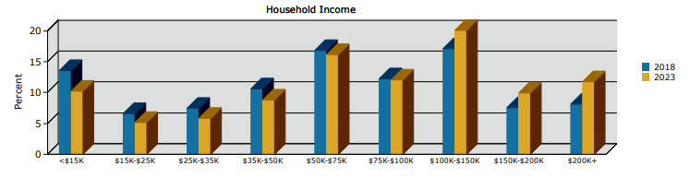
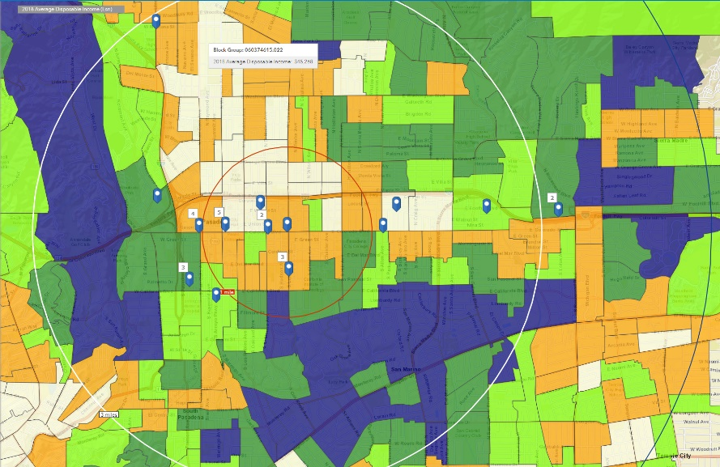
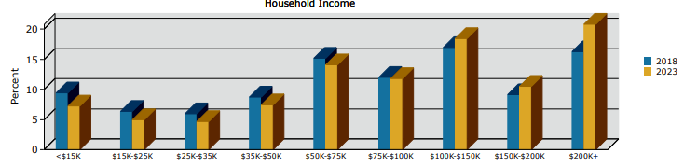
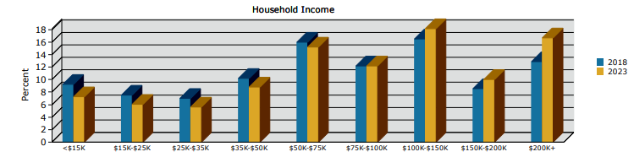
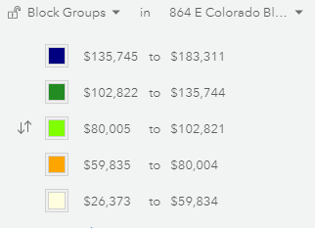
Location Analytics-II
Average disposable income
1 mile radius
3 mile radius
5 mile radius

Slide 10
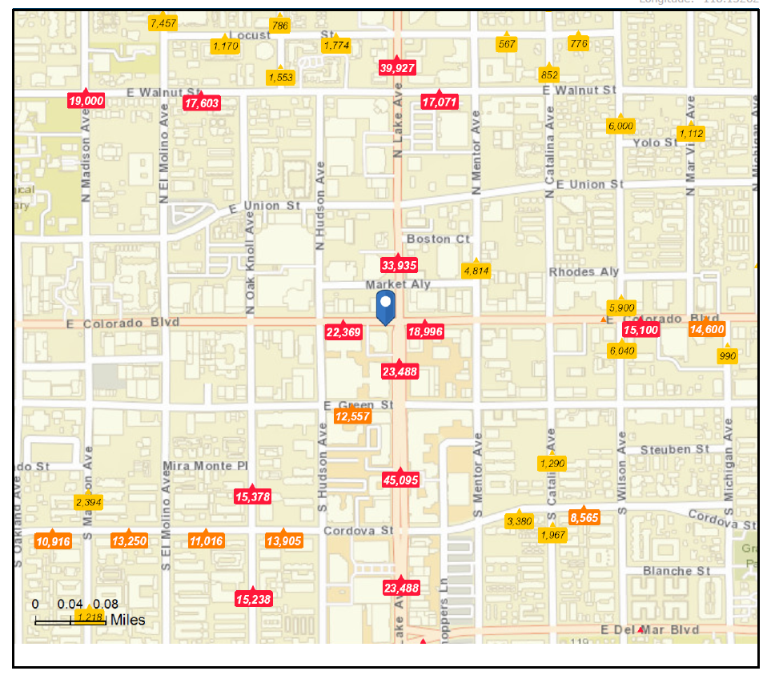
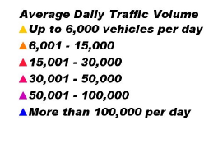
Location Analytics-III
The reason why we chose this location for our store is because of the high traffic of people around that area.

Slide 11
Location Analytics-IV
According to the first diagram, we could see that the areas with the average disposal income from $135,745 to $183,311 in 2018 is surrounded our location in the west and south.
Also on the location analytics III, gives us an insight on how this location has a high traffic of people around that area. So by combining these two conditions, we believe that the high traffic situation would bring more customers with disposable income to visit our store.

Slide 12
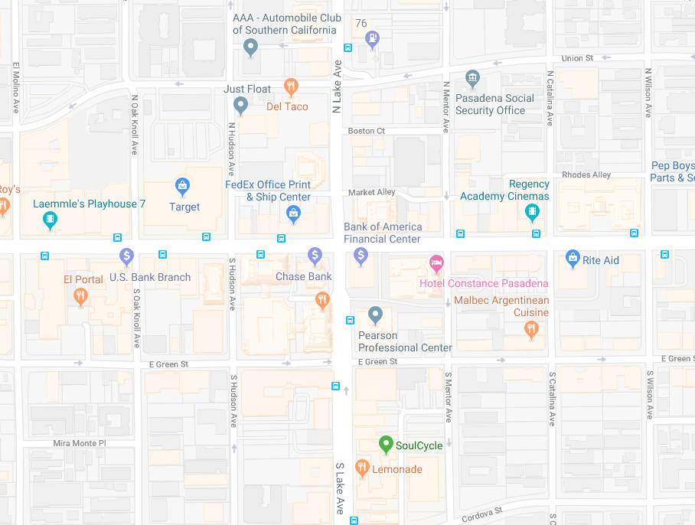
Location Analytics-V
Around - 864 E Colorado Blvd, Pasadena, California, 91101

Slide 13
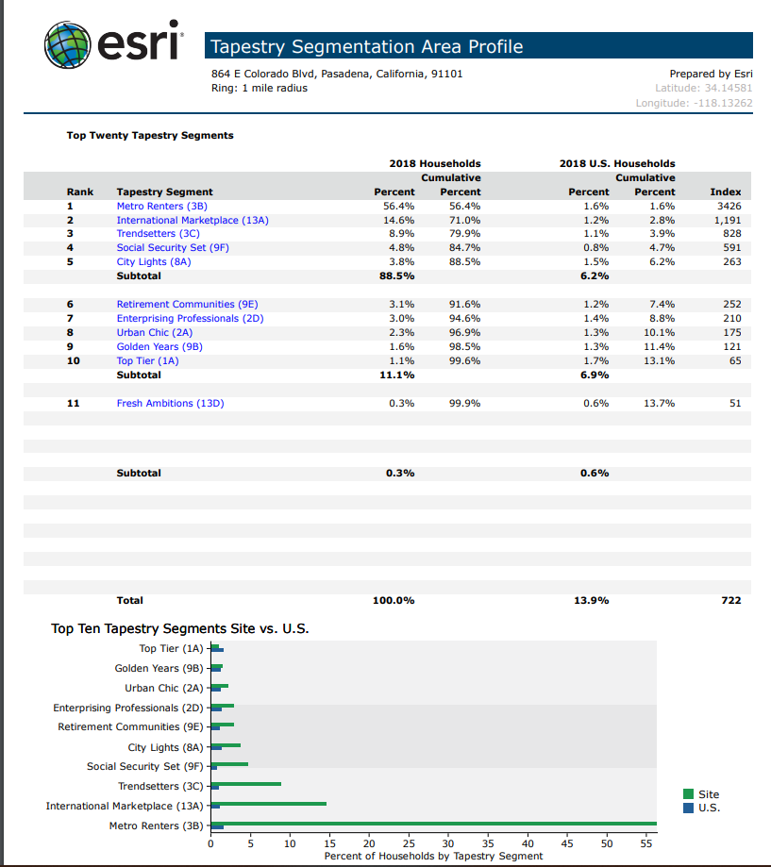
Location Analytics- VI
According to the tapestry report, over 50% of the population within our location satisfies our targeted customer’s age. Households in this location would increase by 580.
While the home value over $500K is 53%.
The Median Household Income is at a 4.45%, while the household income over $75K will keep increasing from 2018 – 2023.
All of the categories provided show the we would have good prospects with this location.

Slide 14
Marketing Strategy
The marketing strategy will be base on attendance (promotion with a booth). Show part of the jewelry collection and advertise their value.
The use of social media will be utilized to target our demographic audience in Pasadena given the information gathered on GIS.
While the use of website will allow our business to increase visibility in the market, collect information, and process orders.
Another option will be similar as the first by promoting the usage of networks like, art/jewelry galleries. By creating relationships with galleries that would be willing to exhibit some of the Stores pieces, will help us to promote our store and to gain recognition from potential customers.

Slide 15
Messaging Strategy
We are a small Boutique Brand with a big vision for the future. Our goal as a company is to utilize bleeding edge technology to construct Beautiful Jewelry that can be customized based on the customers needs.

Slide 16
Are you going to be profitable?
According to analysts at the Retail Owners Institute, the gross margin percent trends for jewelry businesses have stayed relatively consistent in recent years. Gross profit margin is calculated by subtracting the cost of goods from a business's revenues. In 2013, the gross profit margin for jewelry stores was 43.5 percent. In 2017, it was 42.6 percent.
https://smallbusiness.chron.com/percent-profit-margin-retailers-expect-jewelry-73996.html

Slide 17
Conclusion
We can conclude that 3-D Printing Jewelry would be successful.
With the use of 3-D printers it gives one the ability to create different designs with the use of different material. The material will be used as a base model to either improve the prototype or as a mold for the final design. It will help facilitate and lower the cost of creating models for the final product.
At the same time, with using 3-D model it gives customers an endless variety of unique designs to create. This will help attract customers and potential clients to the store. As the number of customer’s satisfied with their purchase increases it will not only help increase the business’s reputation but also, it would help increase our business in general.

Slide 18
Three Wows
One of the three WOWs we found interesting was the profit margin that jewelry stores receive.
A second WOW would be how, interestingly there are not many moving in providing and using 3-D printing technology to help create the base of jewels or even using them.
The Third WOW is even though there are people who have a 3-D jewelry printing business online, why haven’t they opened a store front? With all the information gathered it proves that they will increase their revenues by opening a store front.

